Slide 1
Dental Caries prevention and management
PRESENTED BY : DR. NUPUR DHANAK

Slide 2
Contents
Introduction
Caries prevention
Need for prevention
Aim for prevention
Prevention levels
Preventive measures
Non invasive options for treatment of existing lesions
Operative and minimally invasive treatment options
Maintenance care
CAMBRA (caries management by risk assessment)

Slide 3
Introduction
DENTAL CARIES is a preventable, chronic, and biofilm –mediated disease that affecting close to 2.4 billion people
Its a result of the interaction between cariogenic oral bacteria, fermentable carbohydrate and time on a tooth.
At the tooth level, dental caries lesions result from a dynamic process of demineralization and remineralization
to prevent and manage caries we need to understand the balance between demineralization and remineralization.

Slide 4
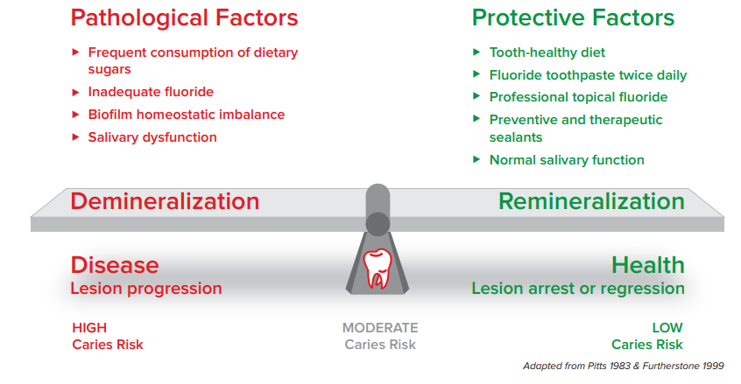
caries balance

Slide 5
Aims of prevention
Limiting pathogen growth and metabolism
Limitation of caries activity.
Early detection of incipient caries.
Identification of high risk patients.

Slide 6
Needs for prevention
Caries progression may cause severe pain
Symptomatic treatment is intensive
Compromises nutrition
The cost of treatment is high

Slide 7
LEVELS OF PREVENTION
Primordial prevention
Primary prevention
Secondary prevention
Tertiary prevention

Slide 8
Primordial prevention
DEFINITION
“It is the prevention of emergence or development of risk factors in countries or population groups in which they have not yet appeared.”
Eg: Efforts directed towards discouraging children from adopting harmful life styles.

Slide 9
Primary prevention
DEFINITION
“Is defined as actions taken prior to onset of the disease, which removes the possibility that the disease will ever occur”
It includes specific protection and health promotion.

Slide 10
Secondary prevention
DEFINITION
“Is defined as actions which halt the progress of a disease at its incipient stage and prevents complications”
It include early diagnosis and prompt treatment.

Slide 11
Tertiary prevention
DEFINITION
Is defined as all measures available to reduce or limit impairments and disabilities ,minimizing suffering caused by existing departure from good health and to promote the patient adjustments to the irremediable conditions”

Slide 12
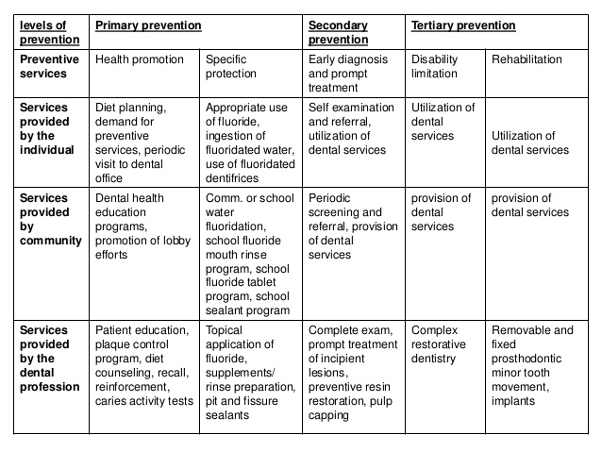

Slide 13
Preventive measures of caries control ds for caries control
Chemical measures
Nutritional measures
Mechanical measures
Preventive method

Slide 14
Chemical measures
Substances which alter tooth surface
Flourides
Iodides
bis- biguanides
silver nitrates
zinc chloride and potassium ferrocyanide
Amorphous calcium phosphate(ACP)
Substances interfere with carbohydrate degradation by enzymatic reaction
Substances which interfere with bacterial growth and metabolism
urea and ammonium compounds
chlorophyll
nitrofurans
vitamin k

Slide 15
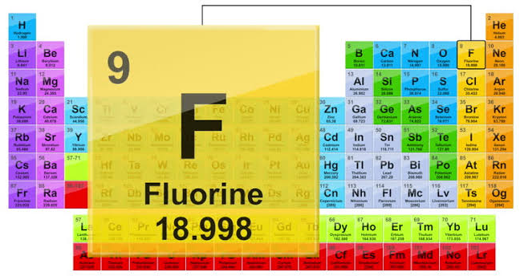
FLUORIDE
Fluorine - Member of halogen family
Atomic weight – 19
Word fluorine derived from the latin term “floure” means to flow
Is a pale ,yellow – green gas.
Most electronegative and reactive element

Slide 16
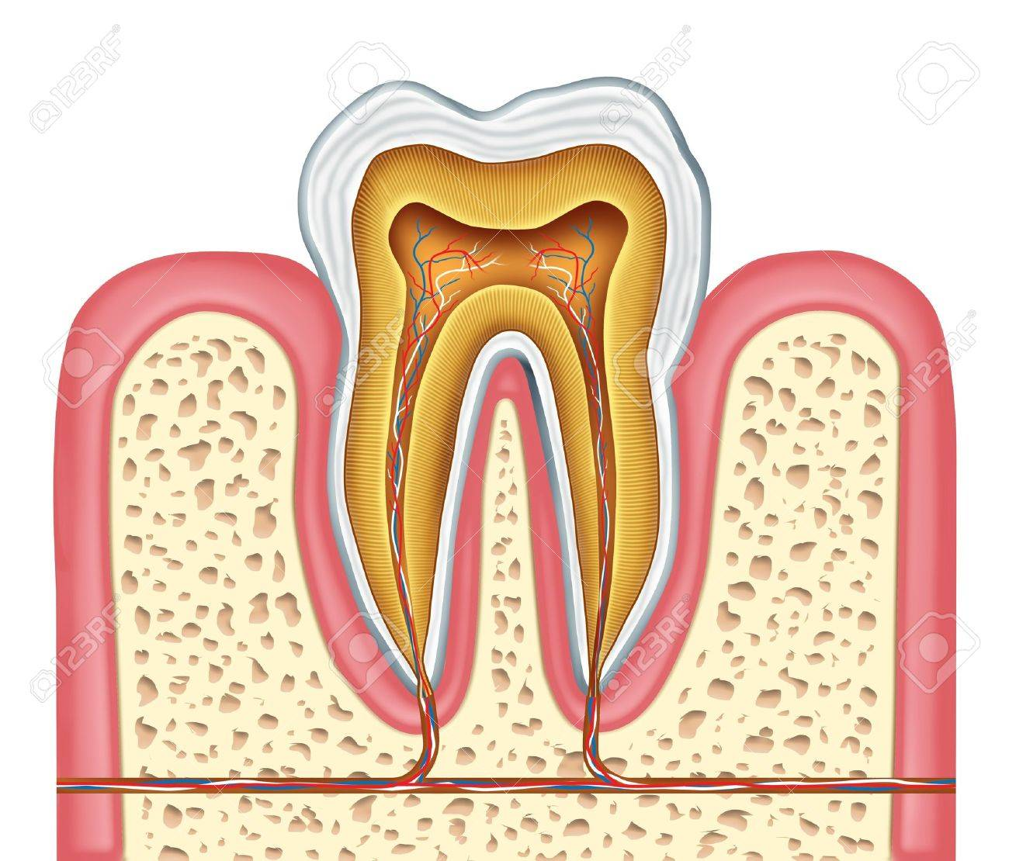
According to WHO fluorine is essential element required for normal growth and development of body.
200-300ppm
2200-3200ppm
4500 ppm

Slide 17
Role of fluoride in dental caries
Mechanism of action
Increase enamel resistance or reduction in enamel solubility
Increased rate of posteruptive maturation
Remineralization of incipent lesions
Interfere with plaque microorganisms
Modification in tooth morphology.

Slide 18
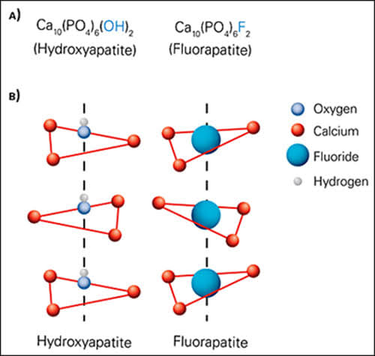
Increase enamel resistance or reduction in enamel solubility

Slide 19
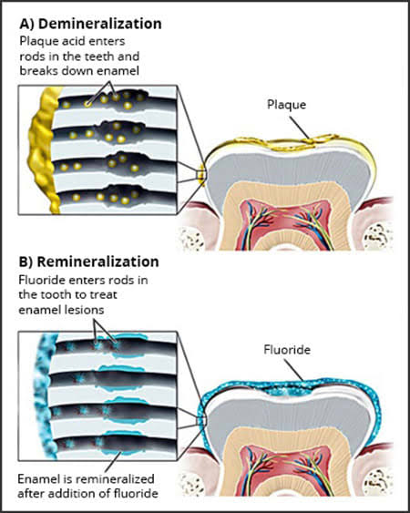
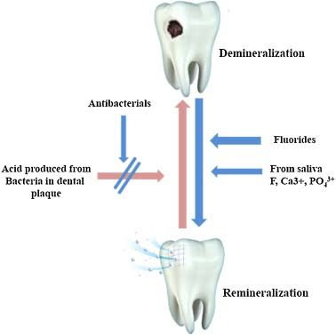
Remineralization of incipient lesions

Slide 20
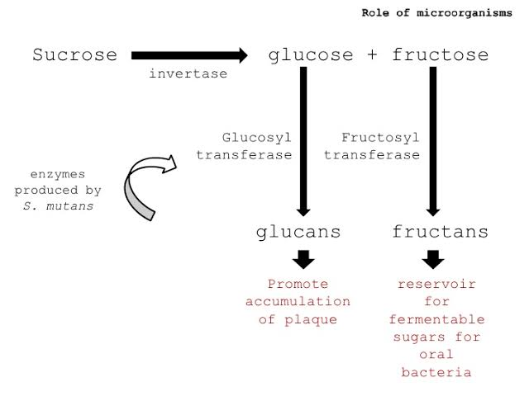
Interfere with plaque microorganisms
FLUORIDES

Slide 21
FLUORIDE DELIVERY METHODS
TOPICAL FLUORIDES
SYSTEMIC FLUORIDES

Slide 22
TOPICAL FLUORIDES
PROFESSIONALY APPLIED
AQUOUS SOLUTION AND GELS
FLOURIDATED PASTE
SELF APPLIED
DENTRIFRICES
MOUTH WASHES
VARNISH
TOPICAL COMPOUNDS
FLOURIDE GELS

Slide 23
PROFESSIONALY APPLIED COMPOUNDS
Typically dispensed by dental professionals in dental office
Use of high concentration of fluoride
Between 5000- 19000 ppm
5- 19 mg F / mL

Slide 24
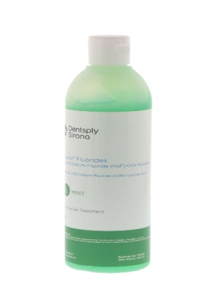
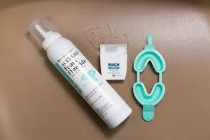
AQUOUS SOLUTION AND GELS
Less than 0.5 ml solution is used
Either it is coated over tooth surface or applied by means of trays.
Agents: NAF, SNF, APF, silver diamine fluoride

Slide 25
Silver diamine fluoride
Silver diamine fluoride(SDF) is a typical solution used as a caries- arresting and anti hypersensitivity agent.
MECHANISM OF SDF
Inhibits demineralization of tooth
Promotes remineralization of tooth mineral
Fight dental caries

Slide 26
HOW TO USE
Removal of biofilm with microbrush for 3 min
Rinse area with water
Apply fluoride solution
Gingival tissue and lips cover with petroleum jelly to avoid staining

Slide 27
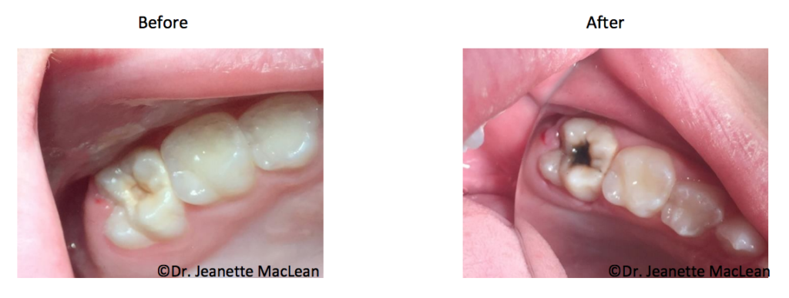
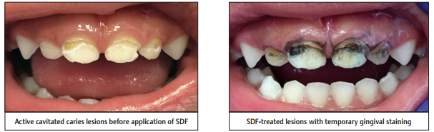
Pros
quick ,easy and painless
Remineralizes natural tooth
Prevent biofilm adhesion
Arrest 80% lesion when applied twice a day
Cons
Not opted for deep cavities
Permenantly stain decay black

Slide 28
Fluoride varnish
Highly concentrated form of fluoride.
Applied to the tooth surface, by dentist or other health care professional
Varnish increase time of contacts between enamel surface and agents.
First fluoride varnish developed by schimdt in 1964.
Better outcome in preventing caries at a lower cost compared to other fluoride treatments .

Slide 29
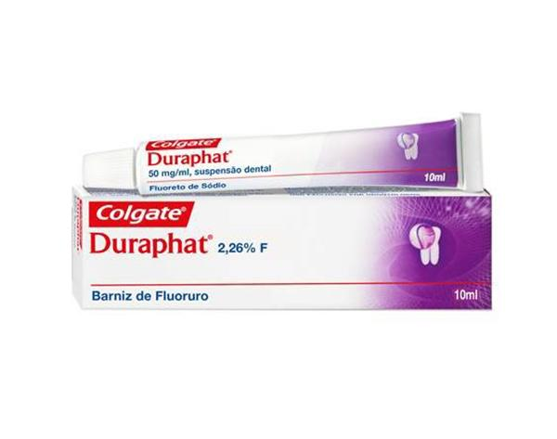
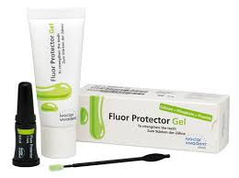
Duraphat
Naf (2.26%)
Fluorprotector
Difluorosaline(0.7%)
carex
Contain 1.8%fluoride
22600 ppm
Caries reduction 30-40%
7000 ppm
Caries reduction 1-17%
Equilant to duraphat
Types of varnish

Slide 30
Advantages
Available in different flavors which can be advantageous when treating younger patients
Varnish dry rapidly and will set even in the presence of saliva
Suitable for use in patients with a strong gag reflex
It has a sticky consistency which helps it to adhere to the tooth’s surface ( LONG CONTACT TIME)
professionally applied fluoride varnish does not appear to be a risk factor for dental fluorosis even in children under the age of 6.
They can be applied easily and quickly

Slide 31
Disadvantages
Due to the color and adherence , may cause a temporary change in the surface color of teeth as well as some filling materials.
Varnish costs more than gel and requires a prescription unlike the gel that is over the counter.
In some patients the taste of the varnish can cause nausea especially when consuming food within the 24 hours post treatment.

Slide 32
TOPICAL FLUORIDE COMPOUNDS
Characteristics | Sodium fluoride 2 % | Stannous fluoride 8% | APF
Technique | KNUTSONS TECHNIQUE | MUHLERS TECHNIQUE | BRUDEVOLD TECHNIQUE
Fluoride concentration | 9200 PPM | 19500 | 12300
pH | Neutral | 2.4 – 2.8 | 3
Frequency of application | 4 At weekly intervals 3,7,11,13 yrs | Biannually | Biannually
Adverse effects | 4 visits in relatively short period of time. | Tooth pigmentation and gingival irritation Unpleasant taste | Acidic, sour ,bitter in taste Cosmetic damage to porcelain and composite restorations
Caries reduction | 30% | 32% | 28%

Slide 33
Self applied fluorides
Dispensed by individual patient at the recommendation of a dental personal.
low flouride concentration between 200- 1000 PPM
0.2 – 1.0 mg Fluoride / ml
Includes fluoride dentifrices , gels and rinses

Slide 34
FLOURIDATED DENTRIFRICES
Introduced by Bibby in 1942 . ( active agent NAF)
Fluoride dentifrice accepted by american dental association in 1964. ( agent stannous fluoride )

Slide 35
Types of dentifrices
Sodium fluoride
NAFconcenetration 0.188-0.254%
Stannous fluoride
Its first intoduced by muhler 1954
Monofluorophosphate
Intoduced 1981
Available fluoride concentration 650ppm
Not used commonly because of staining and pigmentation of teeth
FDA proposed use of monofluorophosphate conc 0.564-0.88%
Available concentration 800ppm
Amine fluoride
Introduced 1963
( Elmex)
Foams less than monofluorophosphate
Properties superior

Slide 36
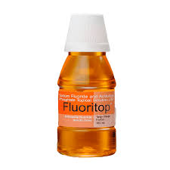

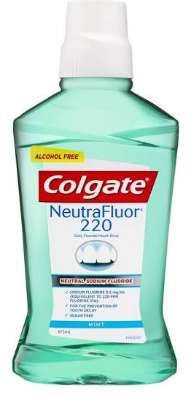
Fluoride mouth rinses
First described by Bibby in 1964.
Includes mainly NAF

Slide 37
Sodium fluoride mouth rinses
Low dose or high frequency rinses
High potency – low frequency rinses
0.2% NAF weekly
225 ppm
30-40% caries reduction
900 ppm
30-40% caries reduction
0.05%NAF daily

Slide 38
Fluoride gels
NAF -5000 ppm
Acidualted phosphate fluoride -5000ppm
SnF -1000ppm
Applied in trays for 4 minuts or brush on teeth for one minute

Slide 39
SYSTEMIC FLUORIDES
COMMUNITY WATER FLUORIDATION
SALT FLUORIDATION
MILK FLUORIDATION
FLUORIDE TABLETS, DROPS AND LOZENGES

Slide 40
Most common form of systemic fluoride application
Optimum level 0.7 ppm
Recommonded school water fluoridation 4.5 ppm
Agents – fluorspar,NAF,silico-fluoride, sodiumsilicofluoride hydrofluorosilicic acid, ammonium silico fluoride
Wespi 1948 in Switzerland
NAF/KF 200,250,350 mg per kg
Introduced by Ziegler in 1953
First community based milk fluoridation program introduced in Bulgaria
Optimum amount (WHO) – 0 to 1 mg / day
NAF – most common

Slide 41
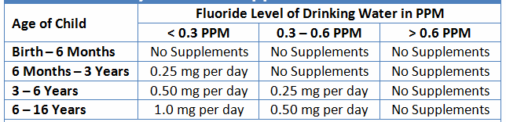
Dietary fluoride supplement schedule
Approved by ADA & AAPD

Slide 42
Toxicity of fluoride
Acute toxicity include:
Nausea
Abdominal cramps
Vomiting
Diarrhea
Increased salivation
Dehydration and thirst
Chronic toxicity include:
Dental fluorosis
Skeletal flurosis

Slide 43
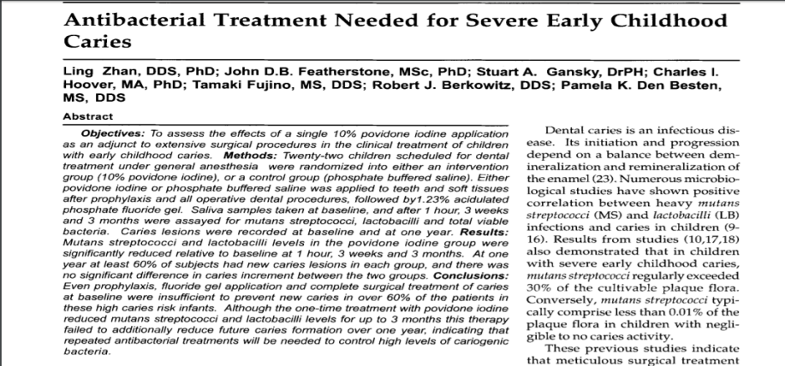
Iodine
Miller (1980) reported the intraoral use of iodine solution as an antibacterial mouth rinse.
kills microorganisms immediately once contact with the organisms.

Slide 44
Disadvantages:
Metallic taste.
Tendency to stain silicate or composite restoration.
Allergic potential.

Slide 45
BIS-BIGUANIDES
Commercially available forms
Chlorhexidine
Alexidine

Slide 46
Chlorhexidine (CHX)
CHX was first available in the United States as a rinse for periodontal therapy at concentration of 0.12%
It act as antiplaque agents and thus potential anti caries agents
possess a net positive charge at physiologic pH.

Slide 47
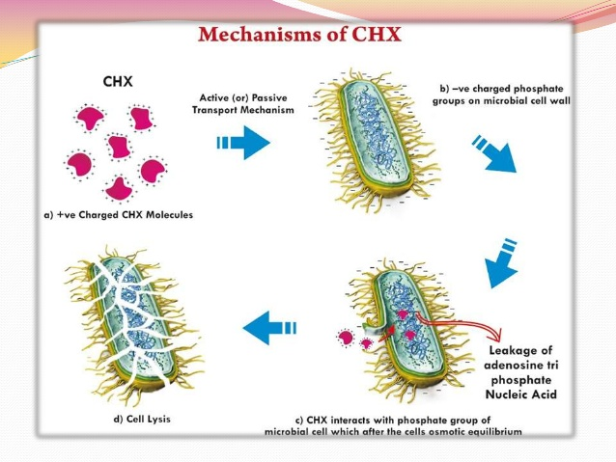
Mode of action
Cell lysis
CHX ineracts with phosphate group of microbial cell which alter osmotic equilibrium

Slide 48
Disadvantages:
Bitter taste
Sodium laurel sulfate(SLS) reduce ability of chlorhexidine gluconate.
Brownish discoloration of soft & hard tissue.
Painful desquamation of mucosa.

Slide 49
ALEXIDINE
Cationic bisbiguanide
Highly effective against bacteria
Both bactericidal and bacteriostatic
Faster acting than CHX ( faster membrane disruption)

Slide 50
Silver nitrate
It was used clinically for many years to prevent or arrest dental caries.
silver
Occludes enamel lamellae
Combine with inorganic portion –Makes less soluble

Slide 51
ZINC CHLORIDE AND POTASSIUM FERROCYANIDE
Gottleib proposed they act by effectively impregnating the enamel and seal off caries invasion pathways.
But clinical results did not coincide with the theories proposed

Slide 52
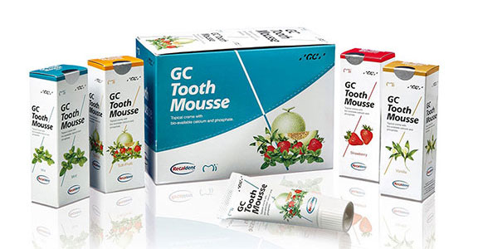
Amorphous calcium phosphate(ACP)
ACP is commercially available reactive and soluble calcium phosphate compound.
It releases calcium and phosphate ions to remineralize the enamel when it comes in contact with saliva.
Casein phosphopeptide(CPP) is a milk-derived protein that bind to tooth biofilm and act as a vehicle to deliver ACP.
It sold under brand names include RECALDENT and TOOTH MOUSSE.

Slide 53
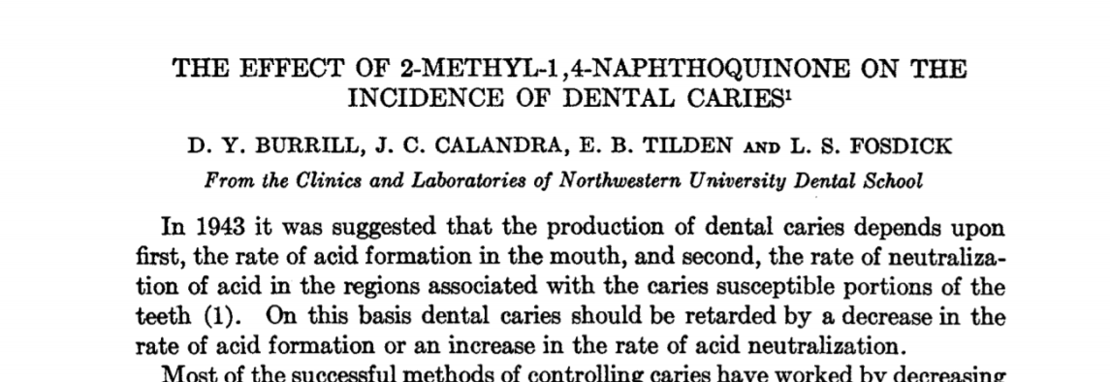
Vitamin K
interfere with carbohydrate degredation through enzymatic reaction/ alterations.
2-methyl-1,4-naphthoquinone ( vitamin k ) was suggested by Fosdick as a anticaries agent.
Invitro studies have found it prevents acid formation in incubated mixtures of glucose & saliva.

Slide 54
Substance which interfere with bacterial growth and metabolism
Urea
Upon degradation by urease yields ammonia which neutralizes acids & interferes with bacterial growth. (Stephan et al).
Decrease oral bacteria count & increase the salivary pH to over 8 for more than an hour after an quinine-ammonia mouthwash. (Wach et al)
Notes:
Article

Slide 55
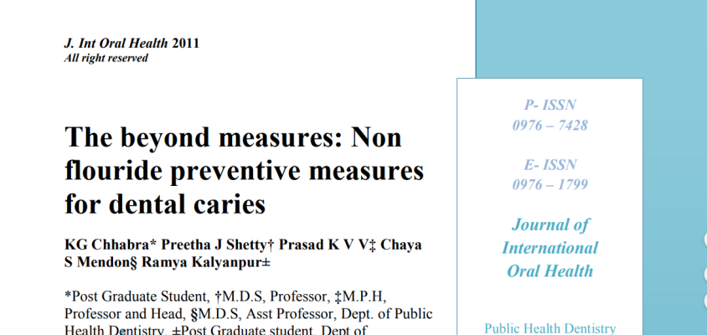
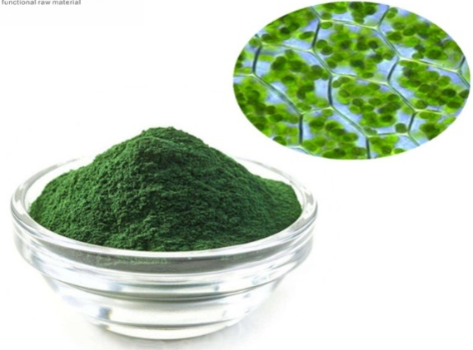
Chlorophyll
Bacteriostatic against lactobacilli, streptococci & micrococci (Griffith et al).
Sodium copper chlorophyllin prevents or reduces pH fall of carbohydrate- saliva mixtures in vivo (Shaffer et al).

Slide 56
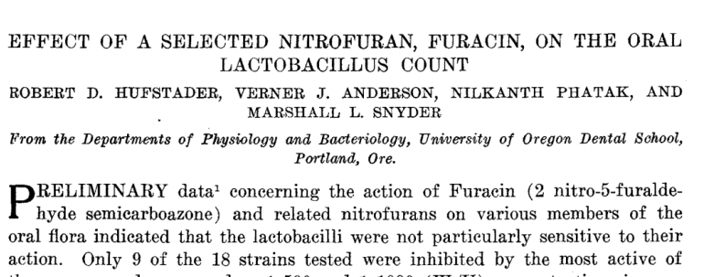
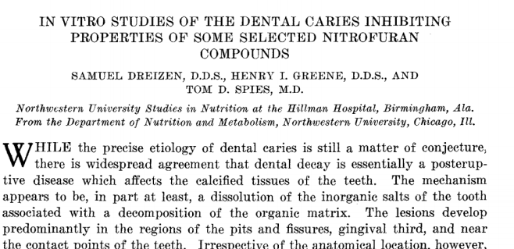
Nitrofurans
They are the derivatives of furfural.
They exert a bacteriostatic and bactericidal action in many Gram positive and Gram negative organisms.
Even in low concentrations, acid production in saliva from caries active persons was prevented. (Driezen et al 1951).

Slide 57
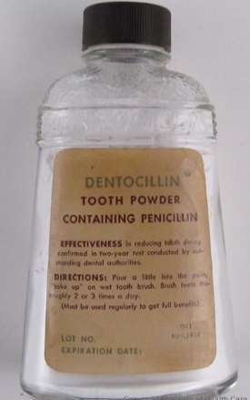
ANTIBIOTICS
Tested as an anticariogenic compound, because of its antibiotic property.
Reduction from an average of 72000 colony count to an average of 300 was found after use of the dentifrice containing 1000 units of Penicillin per gram, for 5 weeks.

Slide 58
ERYTHOMYCIN
35% decrease in plaque formation after a seven day test period of rinsing, then swallowing the agent 4 times a day (LOBENE et al).
Diarrhea - side effect.

Slide 59
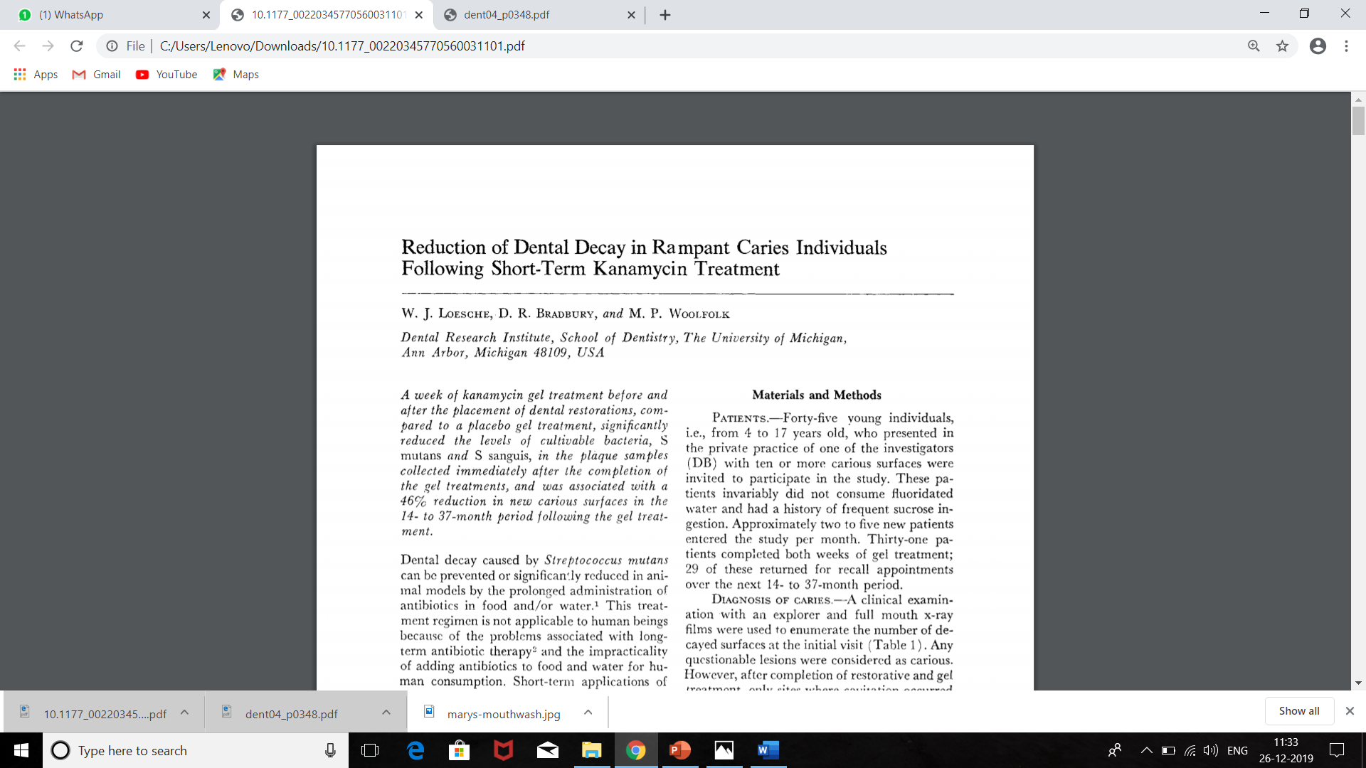
KANAMYCIN
Reduces plaque weight & improves oral health if applied topically.
Reduces S.mutans & S.sanguis population.
5% kanamycin sulfate in 3 times a day for 4to 5 days reduce plaque level
With kanamycin 46% reduction of new carious lesion in 14 to 37 months period.

Slide 60
TETRACYCLINE
Decrease plaque scores when used as 0.5 percent mouthwash three times a day for five days in place of mechanical oral hygiene (Loe et al).
VANCOMYCIN
Temporarily suppress streptococcus mutans when applied to the teeth of children as a 15 percent gel on twice a day for five successive days.
Diminution in s. mutans was found following testing with 1 percent vancomycin paste.

Slide 61
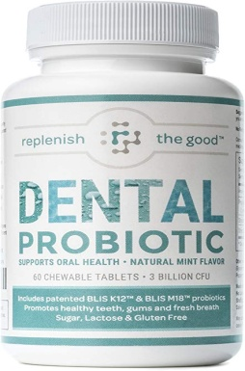
Probiotics
“ Live microorganisms which when administered in adequate amounts confer a health benefit on the host”. (WHO)
Probiotics are nonmodified human isolates from healthy individuals .
Most of them belong to the lactobacilli and bifidobacteria groups which are naturally present in the intestinal flora.

Slide 62
Mechanism of action
Probiotic bacteria compete for nutrients and binding sites in the biofilm.
Probiotic bacteria stimulate the specific and nonspecific immune response through activation of T cells and production of cytokines that mediates the inflammatory process.
When attached, probiotic bacteria can produce bacteriocins (eg, hydrogen peroxide ) that hamper and inhibit growth of a variety of bacteria.

Slide 63
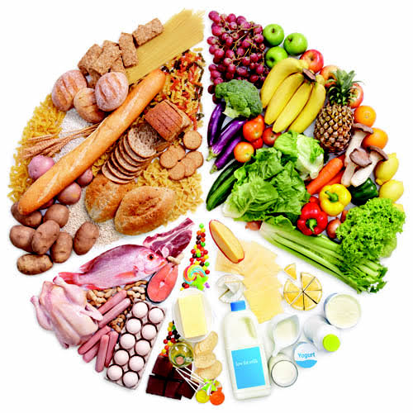
NUTRITIONAL MEASURES
Nutrition: The sum processes concerned in the growth, maintenance and repair of living body as a whole or its constituent parts. (Oxford Dental Dictionary)
"Diet refers to the customary allowance of food and drink taken by any person from day to day.
The diet may exert an effect on caries locally in the mouth by reacting with the enamel surface and by serving as a substrate for cariogenic microorganisms.“ (Newbrun, E. Cariology. Third ed. 1989).

Slide 64
DIETARY ANALYSIS
Objectives of a dietary analysis includes
To obtain an overall picture of the types of food in the patient diet, food preference and quantity of food eaten.
Correction of diet imbalances that could effect the patient's general health & also reflected in his oral health.
Modification of dietary habits, particularly the ingestion of sucrose containing foods in forms, amounts and circumstances that promote caries formation.
To provide a basis for making individual recommendation for changes in diet, important to the health of the oral mucosa and the prevention of dental caries.

Slide 65
Diet analysis program consists
The interview, where diet diary forms are introduced with a brief discussion of the purpose of diet counseling.
A 24 hour diet record is prepared to get an idea of food being consumed.
A six days diet diary is advised to be prepared by the patient.

Slide 66
FOOD DIARY OF WEEK
 | SUN | MON | TUE | WED | THUR | FRI | SAT
BREAKFAST TIME _____
SNACK TIME _____
LUNCH TIME _____
SNACK TIME _____
DINNER TIME _____
SNACK TIME _____

Slide 67
Sugar factors are isolated.
Patient is educated about the role of sugar in the decay process & the consumption of acceptable substitutes .
Provision for a continuous positive reinforcement are planned.
Patient is informed about the consequences of frequent snacking

Slide 68
DIETARY COUNSELLING
FIRST APPOINTMENT
In 15 to 20 minutes the diet diary forms are introduced to the patient.
PATIENT EDUCATION:
The cariogenic potential of a patient's diet is evaluated by determining the total number of exposures to sucrose containing foods during 6 consecutive days.
Notes:
Stefan curve

Slide 69
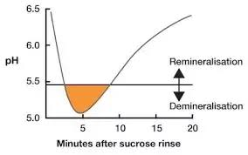
Total time of exposure to acid = (total exposure X 20minutes)
According to Stephan's curve the pH of the plaque drops and remains below the critical level ( 5.5 ) for an average of 20 minutes after the introduction of sucrose into the mouth.

Slide 70
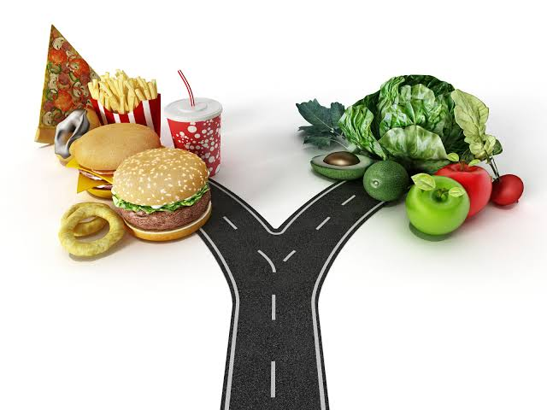
Dietary interventions
Use sugared food during meal time .
Food consumption followed by appropriate oral hygiene measures.
To reduce the frequency of snacks, sufficient amount of food should be taken during breakfast, lunch and dinner at regular intervals.
If hungry in between meals, healthy snacking is advised.
Sweets or beverages - eat or drink them right after meal.
To quench thirst - plain water is preferred to sweet beverages.

Slide 71
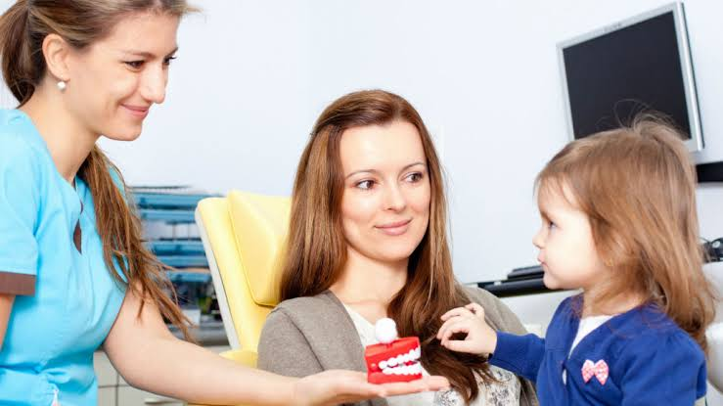
RECALL VISITS
In regular intervals, the dentist should evaluate the patient's progress and provide psychological reinforcement.
Reinforcement is provided by praising the patient's efforts
Needful Improvements should be made in the diet.
Emphasis should be placed on making the patient fully aware of the benefits derived from the program.

Slide 72
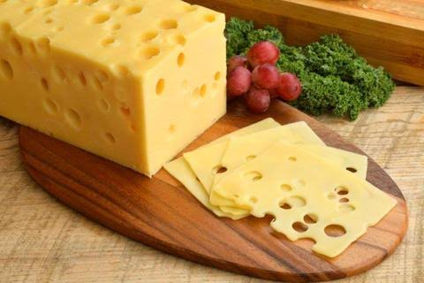
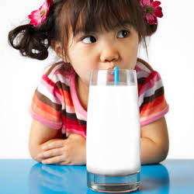
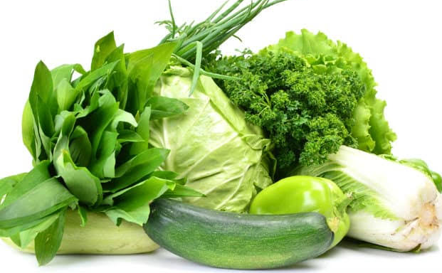
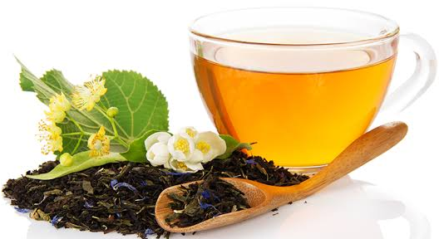
Food with anticariogenic effects
Milk - contain lactose ( least cariogenic)
Cheese ( casein phosphatase)
Fibrous food - Raw vegetables and grains
Green tea and black tea
Sugar substitutes and artificial sweeteners

Slide 73
SUGAR SUBSTITUTES
Are less cariogenic or non-cariogenic.
Sweeteners stimulate the flow of saliva.
Have a smaller role or no effect on bacterial glycolysis.
Plaque pH raises with sweeteners, it mobilizes the calcium and phosphates for remineralization of the tooth surface.
In children consuming sucrose containing snacks more frequently, it is ideal to replace the sucrose by sugar substitutes.

Slide 74
Types of sweetners
Non-caloric Sweeteners
Saccharin
Aspartate
Caloric Sweeteners.
fructose
lactose
sorbitol
Xylitol

Slide 75
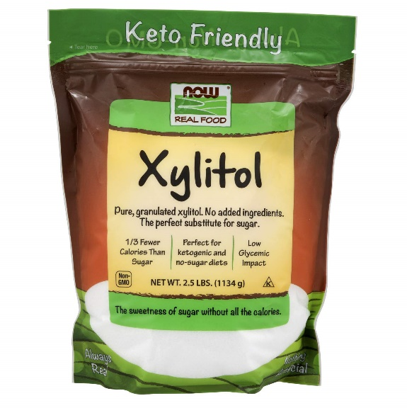
Xylitol
Non-acidogenic - sugar alcohol .
Added in chewing gums, ice creams, jams, cookies and soft drinks.
Advantages
Allows remineralization of initial enamel lesions.
When incorporated in chewing-gum, it stimulates salivary secretion.
Disadvantages
Reports of Urinary bladder calculi formation, epithelial hyperplasia & neoplasia of the bladder.
laxative effect at high concentration.

Slide 76
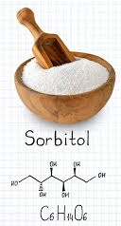
Sorbitol
low cariogenic sugar substitute.
sweetener in chewing gums, soft drinks, cookies and jams.
Not as sweet as sucrose.
Disadvantage
is that sweets made of it cannot be stored for long.

Slide 77
Coupling sugar
Very effective sugar substitutes.
Anticariogenic & exactly resembles sucrose.
Widely used in a variety of snacks.
Too expensive.

Slide 78
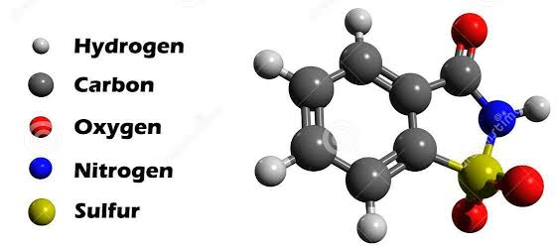
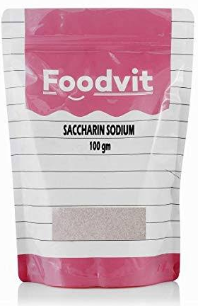
Saccharin
It is non-caloric, and less cariogenic.
Leaves some bitter after taste.
Highly intense sweetener

Slide 79
MECHANICAL MEASURES
TOOTHBRUSH
DENTAL FOLSS
WOODEN TOOTHPICKS

Slide 80
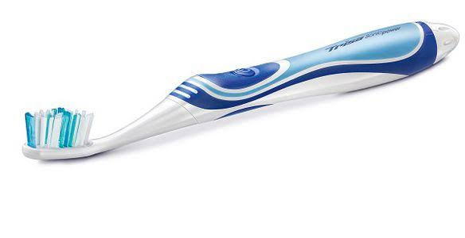
TOOTHBRUSH
The bristle toothbrush appeared about the year 1600 in China
First patented in America in 1857.
TOOTHBRUSH DIMENSIONS(ADA specifications)
Total length: 6.0-7.5 inches
Length of brushing plane: 1-1.25 inches
Width of brushing plane: 5/16-3/8 inch
Bristle height: 7/16 inch
Bristle diameter
Soft: .007 inch
Medium: .012 inch
Hard: .014 inch

Slide 81
BASS TECHNIQUE
Place head of the brush parallel to the occlusal plane.
Establish a 45 angle between bristles and long axis of the head
Place bristles in the gingival sulcus as well as partially into the embrasure.
Move back and forth with vibratory motion 20 strokes per segment.

Slide 82


Slide 83
Advantages
Easy to master.
Concentrates cleaning in areas where plaque accumulates.
For any patient with or without periodontal involvement.

Slide 84
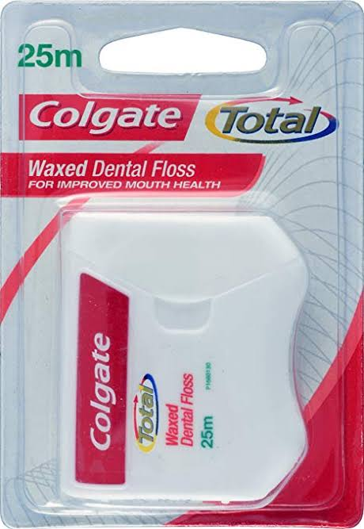
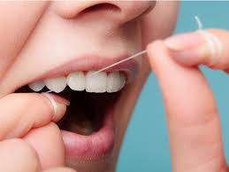
DENTAL FOLSS
Dental floss is best indicated for plaque and debris removal from embrasure where the papilla fills the interproximal space, and the teeth are in contact.
METHODS OF FLOSSING – SPOOL METHOD
Take a floss 12-18 inches long. Wrap around the right middle finger 2-3 times and then around left middle finger..
Pass through contact using a gentle seesaw motion.
Pass floss below the gingival margin. Wrap it tightly around the tooth in a “C” shape. Move the floss up and down, 3 or 4 strokes. Remove floss using a seesaw motion

Slide 85


Slide 86
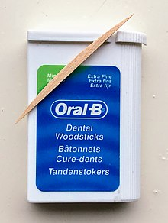
WOODEN TOOTHPICKS
indication
Concave proximal surfaces.
Furcation areas.
Class II and III embrasure spaces.
Also used to introduce fluoride and chlorhexidine into proximal areas.

Slide 87
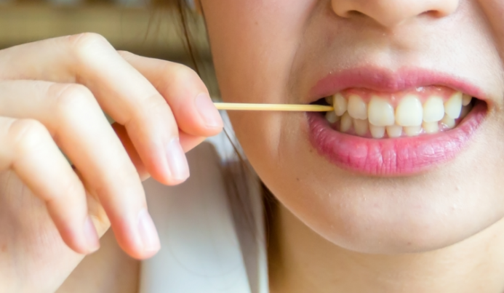
Disadvantages of toothpicks
Causes breakdown of tooth
Causes increased interproximal spaces

Slide 88
Enameloplasty
Removal of a shallow, enamel developmental fissure or pit to create a smooth , saucer–shaped surface that is self cleansing or easily cleaned.
Indications
Fissure depth less than ¼ to 1/3 the thickness of the enamel.
Procedure
Developmental faults are removed with the side of a flame shaped diamond stone, leaving a smooth surface.

Slide 89
PIT AND FISSURE SEALANTS ( Bodecker 1929)
A fissure sealant is a material applied to occlusal surfaces of the teeth in order to obliterate the occlusal fissures and remove the sheltered environment in which caries may thrive (Gordon 1962).
Non invasive
Preventive
Seals deep narrow grooves

Slide 90
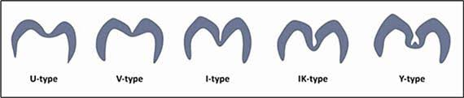
Types of fissures

Slide 91
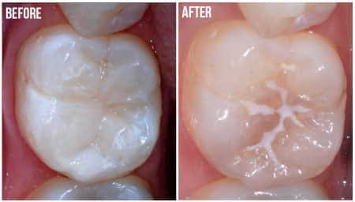
Indications of pit & fissure sealants
Presence of deep occlusal pit and fissures of newly erupted teeth (molars and premolars).
Presence of lingual pits or palatal pits in relation to upper lateral incisors and molars.
Children and young people with medical, physical or intellectual impairment with high caries risk.

Slide 92
Contraindications
Presence of shallow pit and fissures of molars and premolars.
An open occlusal caries lesion with extension into dentin.
Presence of proximal caries extending on to occlusal surface.
Partially erupted tooth where in isolation is a problem.
Uncooperative patient (getting adequate dry field is a problem).

Slide 93
Evaluate pit and fissure surfaces
Caries free
Questionable
Enamel Caries
Dentin Caries
Restore
Seal
Seal
Seal- if at risk for caries based on an evaluation of pit & fissure morphology, eruption status, caries pattern,patient's perception/desire for sealant
Don't seal-Monitor if the individual and the teeth and are not at risk

Slide 94
Generations of sealants:
i. First generation sealants- ultraviolet light cure
ii. Second generation - chemically cured (autopolymerized),
iii. Third generation - visible light cure.
iv. Fourth generation- contain fluorides

Slide 95
TYPES OF FISSURE SEALENT
Resin based sealants
Glass ionomer sealants
Flouride containing sealants

Slide 96
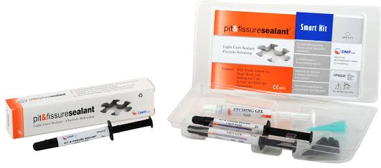
Resin based sealents
POLYURETHANES
first resin cement commercially marketed.
Too soft and totally disintegrated in the mouth after 2 or 3 months
CYANOACRYLATES
Disintegrated after a slightly longer time.
use has been discontinued on account of low shelf-life and high instability.

Slide 97
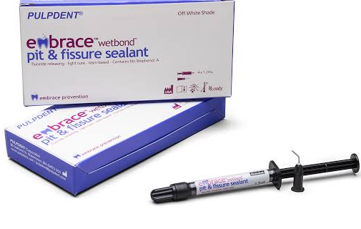
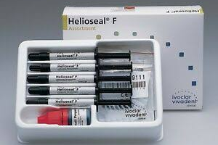
BISPHENOL GLYCIDYL METHYLACRYLATE (BIS-GMA)
It is a mixture of Bis-GMA and methyl methacrylate.
Nuva-Seal ( 1972) - first successful commercial sealant to be placed on the market.

Slide 98
Advantages
They are bonded to underlying enamel.
They form a tight seal, which prevents leakage of nutrients to the microflora in deeper parts of the fissure.
Greater longevity.
Clinical limitation
Difficulty of handling in a moist environment.
salivary contamination will result in failure of the sealant.

Slide 99

GLASS IONOMER SEALANTS
An alternative to resin sealants, ( Where resin sealants are contraindicated)
Indication
primary molars have deeply pitted or fissured surfaces
In cases where isolation may be difficult
Treatment of permanent first or second molars that have not fully emerged
Situations where a “transitional” sealant may be considered before placement of a “permanent” resin sealant

Slide 100
Clinical advantages
Ability to bond chemically to dentin and enamel without the use of the acid-etch.
Technique which makes them less vulnerable to moisture.
Active fluoride release into the surrounding enamel.
Disadvantages
Poor retention- as short as 6 to 12 months.

Slide 101
FLUORIDE-RELEASING SEALANTS
Incidence and severity of secondary caries are reduced
Fluoride uptake provides an additional anticariogenic effect .

Slide 102
Atraumatic Restorative Treatment ( ART)
Atraumatic restorative treatment ( alternative restorative treatment)
Definition
“ A dental caries treatment procedure involving the removal of soft, demineralized tooth tissue using hand instrument alone, followed by restoration of the tooth with an adhesive restorative material, routinely glass ionomer”.
This technique may be modified by the use of rotary instruments.
It has been endorsed by WHO and the International Association for Dental Research as a means of restoring and preventing caries.

Slide 103
GOALS OF ART
Avoiding discomfort
Reducing infection
Preserving tooth structure

Slide 104
Principle of ART
Removing carious lesion using hand instrument
Restoring the cavity with a restorative material that sticks to tooth

Slide 105
Indication
Small and shallow cavities that are accessible to hand instruments
Very young patient
Patient with extreme fear/ anxiety
Mentally or handicapped patients

Slide 106
Contraindications
In presence of swelling or fistula
Carious tooth with pulpal or periapical involvement.
Obvious carious cavity not accessible to hand instruments

