Slide 1
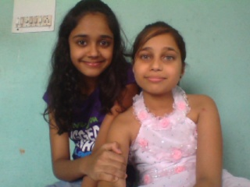
Niharika & anamika

